Slide 1
examples
of
Kingdomly
appropriate clothing

Slide 2
lengths for shorts
and appropriate tops

Slide 3
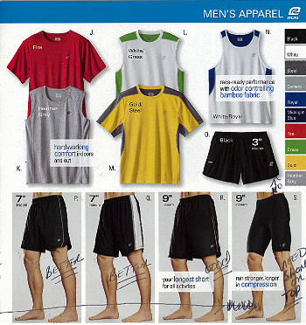

Slide 7
No excessively short shorts, or skirts should be worn without longer bike shorts under them.

Slide 8
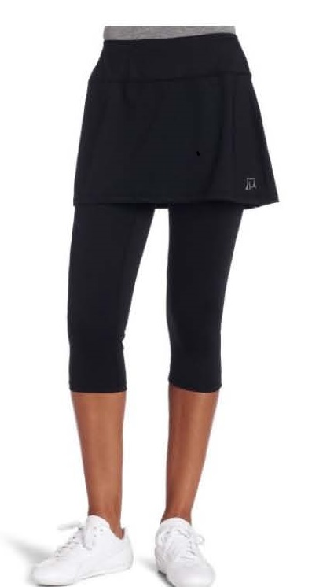
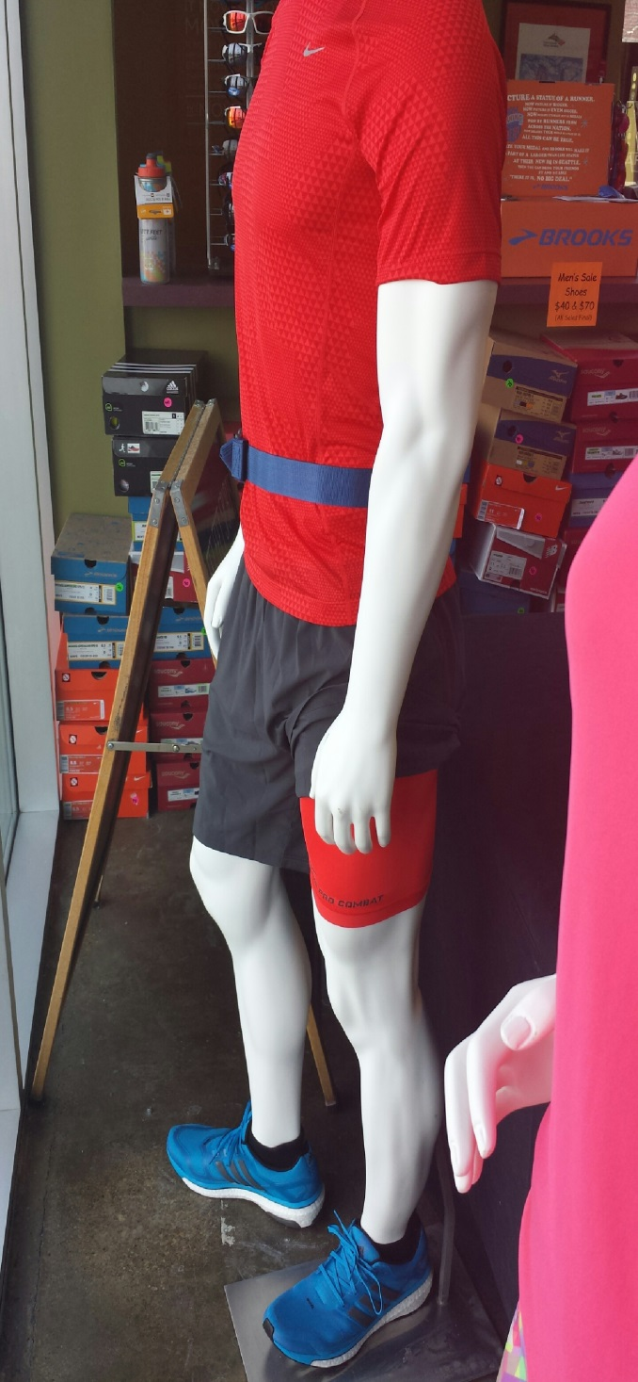
Bike shorts should only be worn underneath looser shorts.

Slide 9
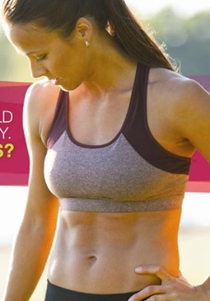
No crop tops, or belly out blouses or running in sports bras are permitted in the Kingdom Running Club.

Slide 10
Our Objective
Is to promote health and fitness in a Christian environment.

Slide 11
We want to make sure that we are always operating above the line!

Slide 12
Please Note: if we pull you over and speak to you about garments it is in love and that we want to always respect you and the running club.

Slide 13
We ask that you consider what you are wearing and make sure that it matches our suggested attire.

